Slide 1
Welcome to Final Year Project by Dr. Imran U Khan

Slide 2
Overview
Managing project --> Progress
Shared folder OneDrive
Zotero – reference management system
Contact with supervisor on email thread
Ethical review form
Aims
Objectives
Table of contents of project

Slide 3
Do you know the answer to these questions?
http://www.sussex.ac.uk/ei/internal/forstudents/informatics/undergraduate/finalyearprojects/informationforstudents
What is the proposal structure?
When is the interim report?
What is the marking criteria for interim report?
What is BCS code of conduct?
If you are not able to answer the questions above, then read it on the link provided.

Slide 4
Marking criteria
http://www.sussex.ac.uk/ei/internal/forstudents/informatics/undergraduate/finalyearprojects/reportmarkingcriteria
Interim reports
85% – 100%: An outstanding report. The student will have performed a detailed analysis of the problem area leading to initial high-level designs for the system and a detailed feasible project plan. There should be clear evidence of relevant background research that is rigorous and scholarly. The report should be superbly organised and presented and lucidly written.
70% – 84%: Students will show a thorough understanding and appreciation of the project material. The student will have performed a detailed analysis of the problem area and a feasible project plan. There should be good evidence of relevant background research. The report should display excellent organisational and presentational skills.
60% – 69%: Students will show a clear understanding of the technical and professional issues involved and have analysed the problem area. There should be evidence of relevant background research. Some issues may have been overlooked but there should be a project plan which suggests the likely success of the project. The report should be organised and written to a reasonable standard.

Slide 5
Why most students do no do well in project module?
Can’t do it in a day or two like coursework of other modules
Can you go to the top of Mount Everest?
Yes: a bit every day
planning, fairly assessing your own progress
Progress every week, no matter how little it is

Slide 6
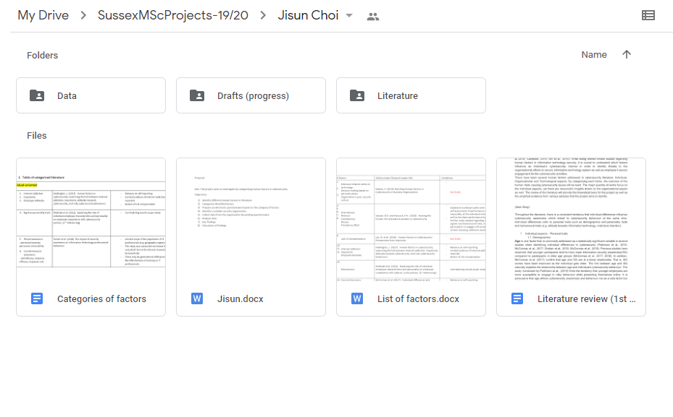
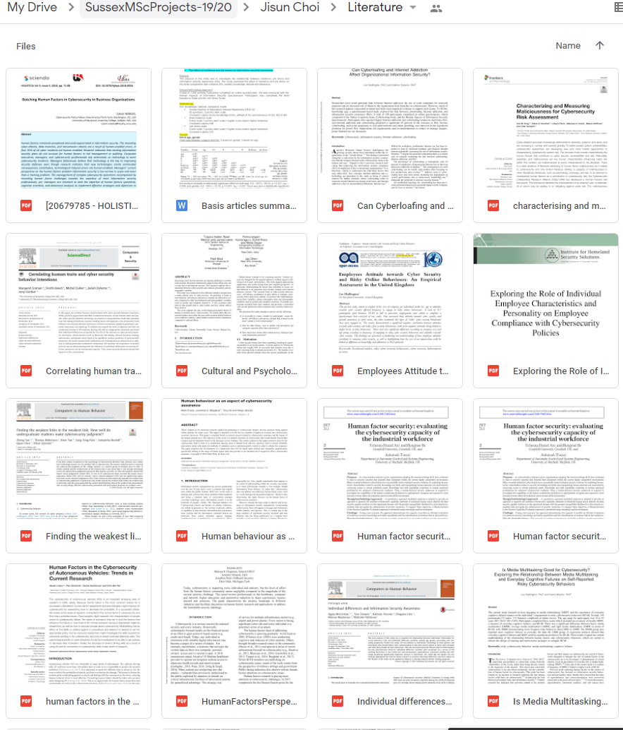
Shared folder on Google drive
Progress for

Slide 7
Zotero
Must use reference management system, Zotero is considered among the best, it is opensource and free to use.
https://www.youtube.com/watch?v=M2wsGCqavPI&list=PL4asXgsr6ek5H5mM9GlA1d-YCb9KvP3Ja
Install, browser plugin (connector) and desktop software (store all references)
Can not see Zotero in MS Word, follow this link https://www.youtube.com/watch?v=aU1CyYzh3E0

Slide 8
Contact with supervisor
Email PLEASE keep on thread so that I can see history of chat.

Slide 9
Research question
I am developing a smart contract is not enough.
I am testing BurpSuite is not enough.
Complexity is part of the marking criteria. Is your project challenging enough? Is this solving a problem?
How smart contract can solve the problems of e-commerce?
What are the problems of e-commerce?
- Technology for a particular industry
- What are features of the technology?
- What are the issues of the industry?
Most importantly what other people have done, how they done and how your work is
similar or different from them.
What are the limitations of traditional pen testing tools against a vulnerable target in AWS?
- What are the pen testing tools?
- What are the frameworks/pen testing methodologies?
Most importantly what other people have done, how they done and how your work is similar or different from them.

Slide 10
Aim of research
Broadly point out what you hope to accomplish
Related to the title, long version of the title
Three important aspects of it:
Why is it necessary?
What is it about? Repeat of the title but that is okay
How are you going to do it?
One or two sentences, don’t write a paragraph of aim.
Example:
Title: An investigation into project management life cycle in automating industries Honda
Aim: This project examines how project management life cycle are implemented in automated industry with a particular view of Honda. The research will be conducted by case study analysis in comparison with other automotive companies.

Slide 11
Objectives
How many? 5-9objectives,
Bold steps, milestones, need to tell story
Extensions, extra objectives. It is okay if you don’t meet them.
Should cover each part of the project:
Smart contract:
Literature review, software development, user/testing, data gathering and analysis, critical evaluation
Security:
Literature review, experiment setup, execute experiment/carrying out investigation, gathering evidence,
analysis, evaluation
Words to use for each part
Literature: study, examine, investigate etc
Software development: design, develop and implement etc
Methodology: collect data, issue questionnaire and analyse data etc
Critical evaluation: compare, discuss, evaluate, conclude and recommend etc.
Use bloom taxonomy for objectives:
to research this and research that does look lazy
SMART objectives: specific, measurable, achievable, relevant and time framed.

Slide 12
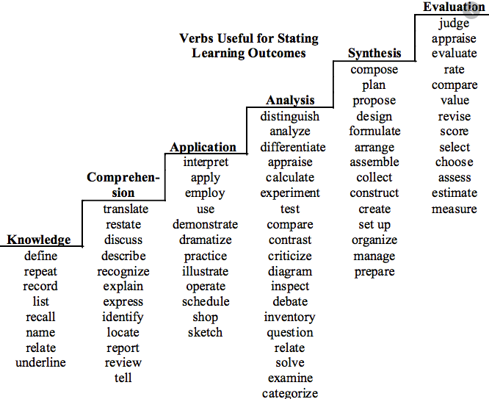

Slide 13
Objectives
Software development general objectives:
To investigate system requirements and produce a Requirements Specification.
To research and write a report on good practice in HCI design.
To design an interface using the findings from the HCI report.
To design and execute a suitable test plan.
Research related objectives:
To conduct a literature search into e-learning, resulting in a literature review of the topic and a definition for the purposes of the project.
To investigate and report on research approaches and methods.
To select and justify an appropriate research design for the project.
To describe any research hypotheses for the project.
To undertake empirical work in accordance with the research design.

Slide 14
What should be your focus for the next few weeks?
In the journey of the project, if you feel you are struggling what to write, you should be sure that you have not read literature about the topic
READ READ READ → Writing will be easy and FUN
- Write your detail proposal and send it to me by next week.
Draft interim report by end of week 5, no later than that.

Slide 15
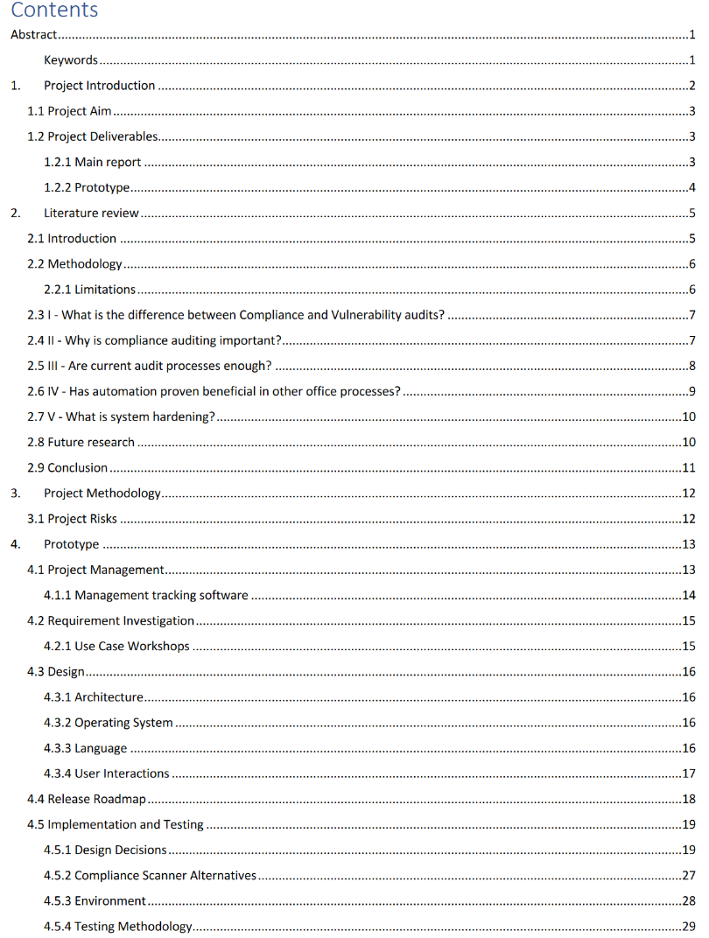
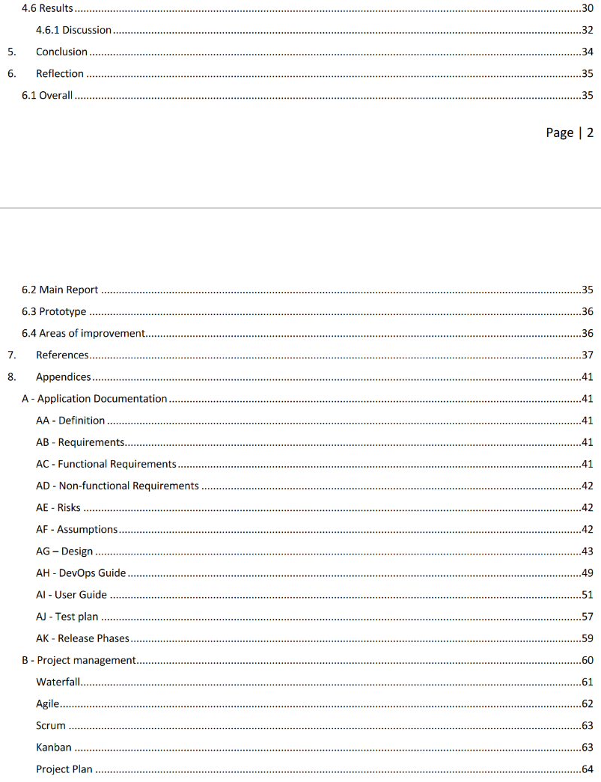
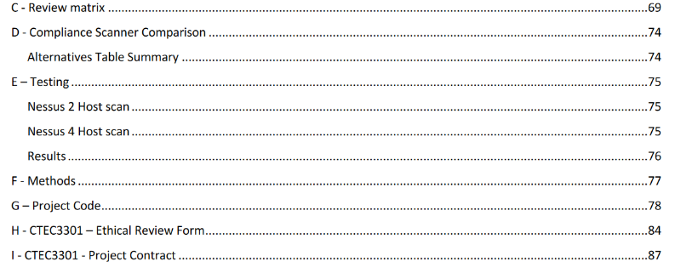
Example 1
Title: Could automation benefit the system hardening compliance audit process?

Slide 16
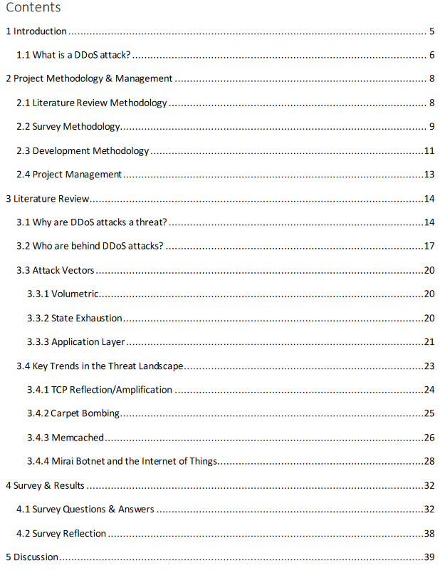
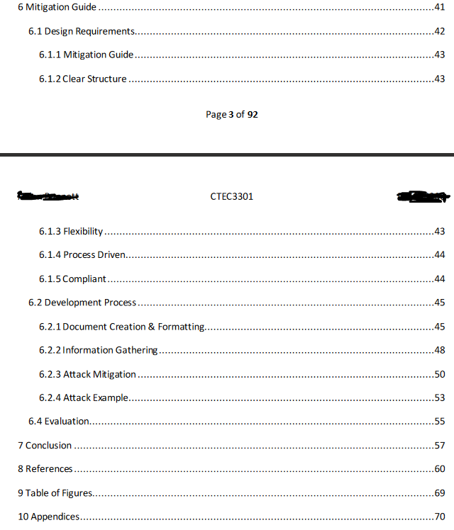
Example 2
How is the DDoS threat landscape evolving and what can be done to mitigate complex attacks?

Slide 17
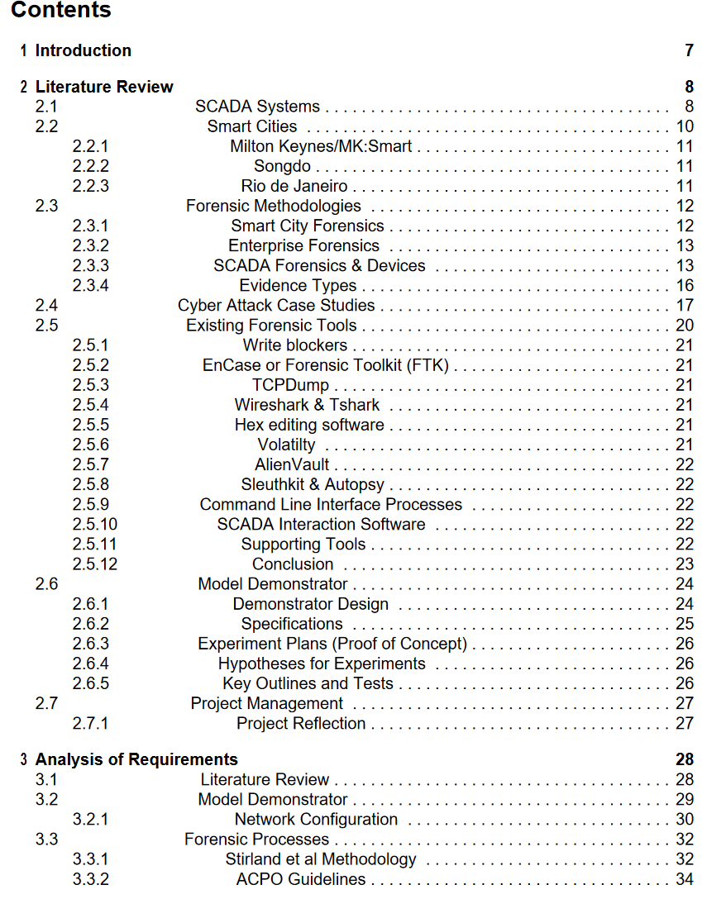
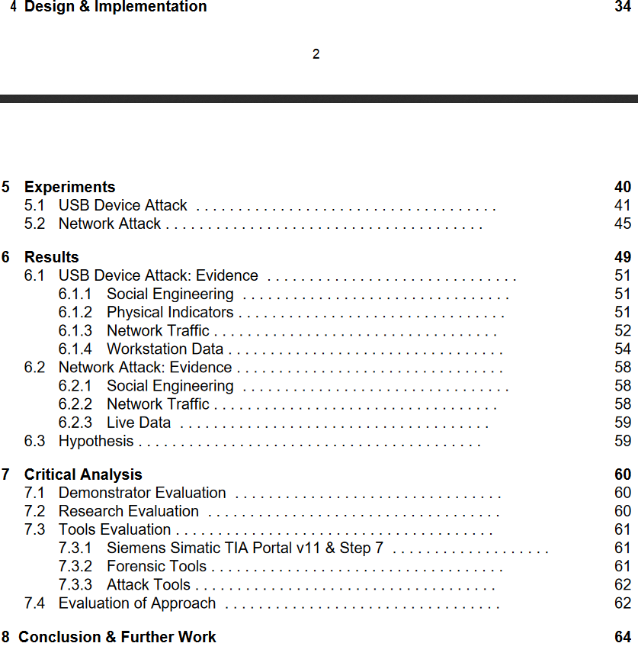
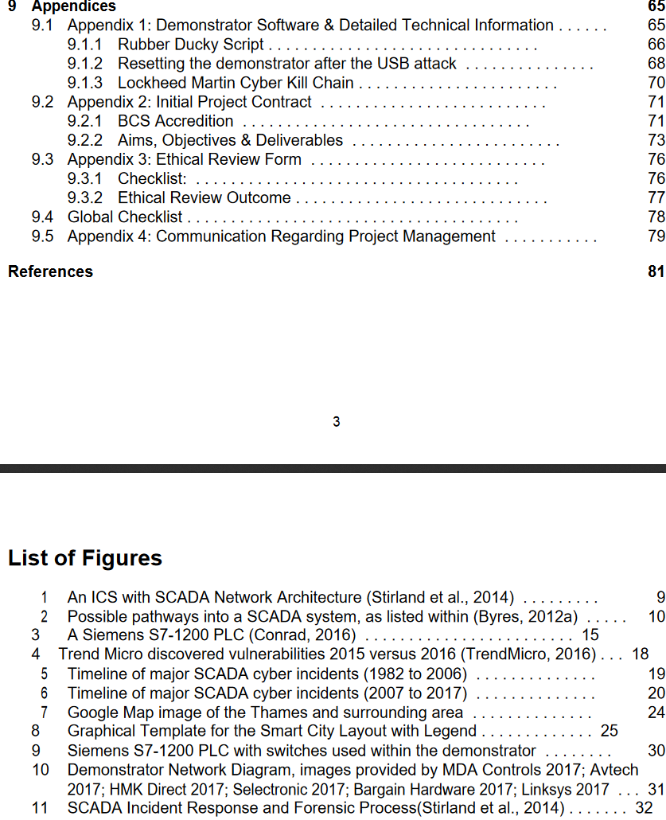
Example 3

